Slide 1









Whiteboardmaths.com
7
2
1
5
© 2004 All rights reserved

Slide 2

The Cosine Rule
B
Pythagoras’ Theorem allows us to calculate unknown lengths in right-angled triangles using the relationship a² = b² + c²
a
c
A
b
C
It would be very useful to be able to calculate unknown sides for any value of the angle at A. Consider the square on the side opposite A when angle A is not a right-angle.
1
2
3
a²
a²
a²
A
A
A
Angle A acute
Angle A obtuse
a² = b² + c²
a² > b² + c²
a² < b² + c²

Slide 3
The Cosine Rule
The Cosine Rule generalises Pythagoras’ Theorem and takes care of the 3 possible cases for Angle A.
1
Deriving the rule
Consider a general triangle ABC. We require a in terms of b, c and A.
A
B
a² = b² + c²
BP² = a² – (b – x)²
Also: BP² = c² – x²
a² – (b – x)² = c² – x²
a² – (b² – 2bx + x²) = c² – x²
a² – b² + 2bx – x² = c² – x²
a² = b² + c² – 2bx*
a² = b² + c² – 2bcCosA
2
c
a
A
P
A
x
b
b - x
C
a² > b² + c²
b
3
Draw BP perpendicular to AC
*Since Cos A = x/c ⇒ x = cCosA
A
When A = 90º, CosA = 0 and reduces to a² = b² + c²
1
Pythagoras
When A > 90º, CosA is negative, ⇒ a² > b² + c²
2
Pythagoras + a bit
a² < b² + c²
When A < 90º, CosA is positive, ⇒ a² > b² + c²
3
Pythagoras - a bit

Slide 4
The Cosine Rule
The Cosine rule can be used to find:
1. An unknown side when two sides of the triangle and the included angle are given.
2. An unknown angle when 3 sides are given.
B
Finding an unknown side.
a² = b² + c² – 2bcCosA
c
a
Applying the same method as earlier to the other sides produce similar formulae for b and c. namely:
A
b
C
b² = a² + c² – 2acCosB
c² = a² + b² – 2abCosC

Slide 5
The Cosine Rule
a² = b² + c² – 2bcCosA
To find an unknown side we need 2 sides and the included angle.
1.
Not to scale
2.
9.6 cm
7.7 cm
65º
a
5.4 cm
40º
8 cm
m
a² = 8² + 9.6² – 2 x 8 x 9.6 x Cos 40º
a = √(8² + 9.6² – 2 x 8 x 9.6 x Cos 40º)
a = 6.2 cm (1 dp)
m² = 5.4² + 7.7² – 2 x 5.4 x 7.7 x Cos 65º
m = √(5.4² + 7.7² – 2 x 5.4 x 7.7 x Cos 65º)
m = 7.3 cm (1 dp)
3.
15º
100 m
p² = 85² + 100² – 2 x 85 x 100 x Cos 15º
p = √(85² + 100² – 2 x 85 x 100 x Cos 15º)
p = 28.4 m (1 dp)
85 m
p

Slide 6


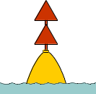
The Cosine Rule
a² = b² + c² – 2bcCosA
Application Problem
A fishing boat leaves a harbour (H) and travels due East for 40 miles to a marker buoy (B). At B the boat turns left onto a bearing of 035º and sails to a lighthouse (L) 24 miles away. It then returns to harbour.
Make a sketch of the journey
Find the total distance travelled by the boat. (nearest mile)
HL² = 40² + 24² – 2 x 40 x 24 x Cos 125⁰
HL = √(40² + 24² – 2 x 40 x 24 x Cos 125⁰)
= 57 miles
∴Total distance = 57 + 64 = 121 miles.
L
H
24 miles
40 miles
125º
B

Slide 7
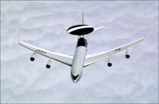

The Cosine Rule
a² = b² + c² – 2bcCosA
An AWACS aircraft takes off from RAF Waddington (W) on a navigation exercise. It flies 430 miles North to a point P before turning left onto a bearing of 230º to a second point Q, 570 miles away. It then returns to base.
(a) Make a sketch of the flight.
(b) Find the total distance flown by the aircraft. (nearest mile)
P
Not to Scale
50º
570 miles
430 miles
Q
QW² = 430² + 570² – 2 x 430 x 570 x Cos 50⁰
QW = √(430² + 570² – 2 x 430 x 570 x Cos 50⁰)
= 441 miles
∴Total distance = 1000 + 441 = 1441 miles.
W

Slide 8


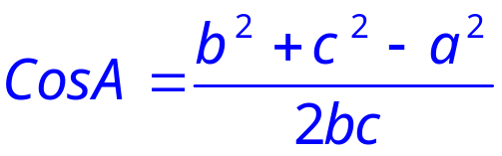
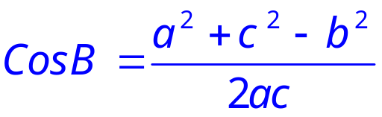
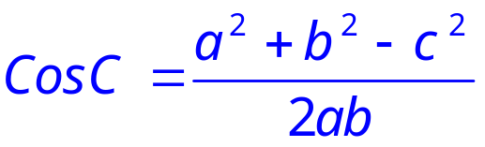
The Cosine Rule
To find unknown angles the 3 formula for sides need to be re-arranged in terms of CosA, B or C.
a² = b² + c² – 2bcCosA
b² = a² + c² – 2acCosB
c² = a² + b² – 2abCosC
B
Similarly
a
c
A
b
C

Slide 9
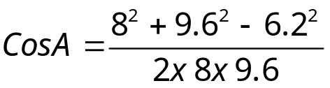
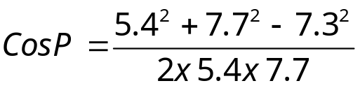


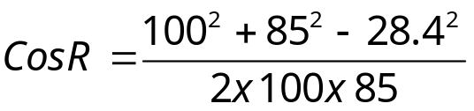

The Cosine Rule
To find an unknown angle we need 3 given sides.
1.
Not to scale
2.
7.7 cm
P
6.2
9.6 cm
5.4 cm
A
8 cm
7.3 cm
3.
R
100 m
85 m
28.4 m

Slide 10
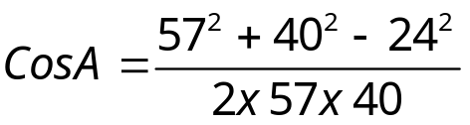


The Cosine Rule
Application Problems
A fishing boat leaves a harbour (H) and travels due East for 40 miles to a marker buoy (B). At B the boat turns left and sails for 24 miles to a lighthouse (L). It then returns to harbour, a distance of 57 miles.
Make a sketch of the journey.
Find the bearing of the lighthouse from the harbour. (nearest degree)
L
57 miles
H
24 miles
A
40 miles
B

Slide 11
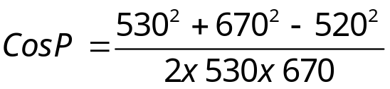


The Cosine Rule
a² = b² + c² – 2bcCosA
An AWACS aircraft takes off from RAF Waddington (W) on a navigation exercise. It flies 530 miles North to a point (P) as shown, It then turns left and flies to a point (Q), 670 miles away. Finally it flies back to base, a distance of 520 miles.
Find the bearing of Q from point P.
P
Not to Scale
670 miles
530 miles
Q
520 miles
W

